Slide 1


Fracking
Just the facts
Lincolnshire
Citizens
Assembly

Slide 2
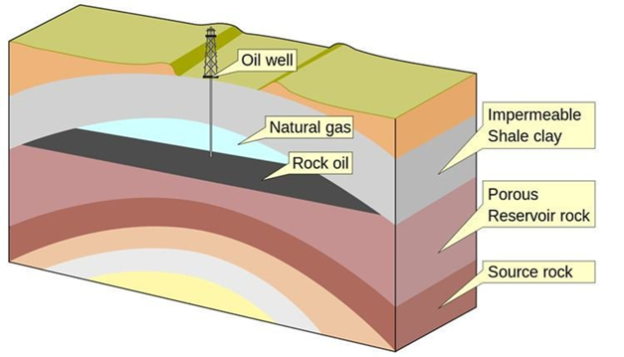
Traditional gas extraction
T
The oil and gas are trapped under a curved layer of rock they can’t get through. The well drills through this layer and the pressure of the rock pushes the oil and gas out. If the pressure falls water can be pumped down to get the last of the oil and gas out.

Slide 3
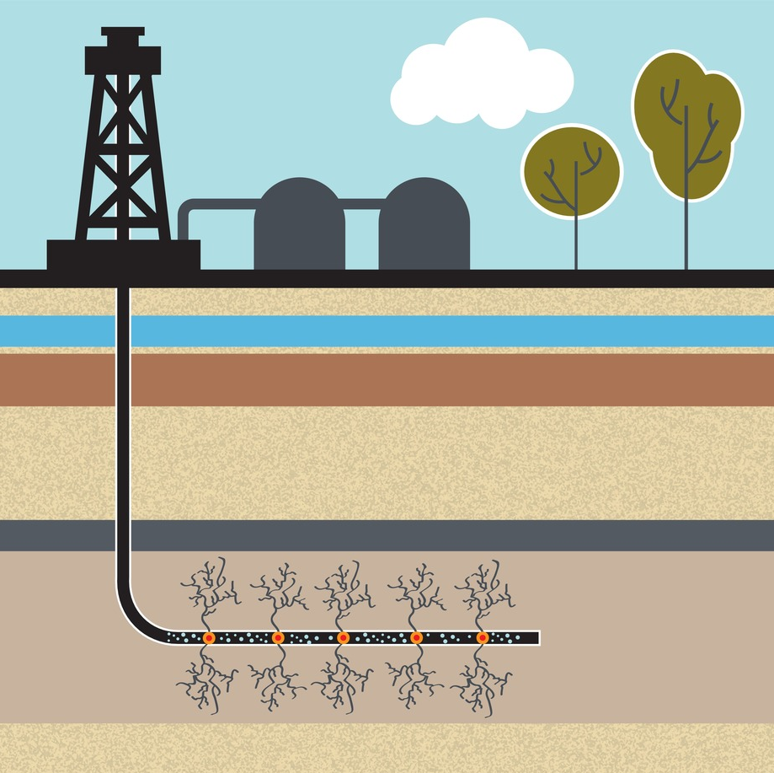
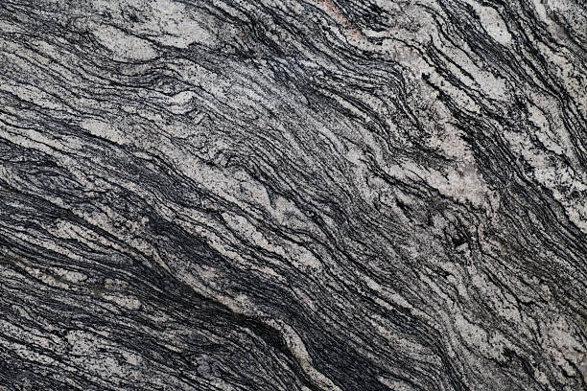
Hydraulic fracturing gas extraction (“fracking”)
The oil and gas are trapped in between the many layers of a type of rock called shale. Water is pumped down under very high pressure to crack this rock layer.
The oil and gas escape and can be pumped back out in the liquid that was pumped down.
The oil and gas are then separated from the fracking liquid.

Slide 4
The differences

Slide 5


The opinions

